Slide 1

CIT-2180 Data and Database Management Chapter 3

Slide 2

Oracle 12c: SQL
Chapter 3
Table Creation and Management

Slide 3
Database Table
A database object
Stores data for the database
Consists of columns and rows
Created and modified through data definition language (DDL) commands
3

Slide 4
Table Design
Table and column names:
Can contain a maximum 30 characters – no blank spaces
Must begin with a letter
Can contain numbers, underscore (_), and number sign (#)
Column names must be unique within the table
No reserved words are allowed (e.g. SELECT)
Every column must have a data type (next slide)
4

Slide 5
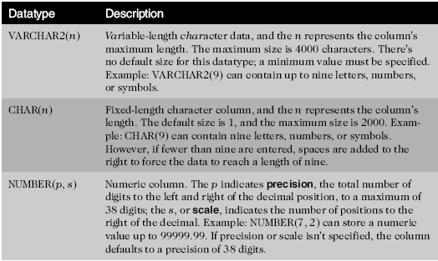
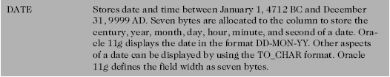
Table Design (continued)
5

Slide 6

Table Creation
6

Slide 7
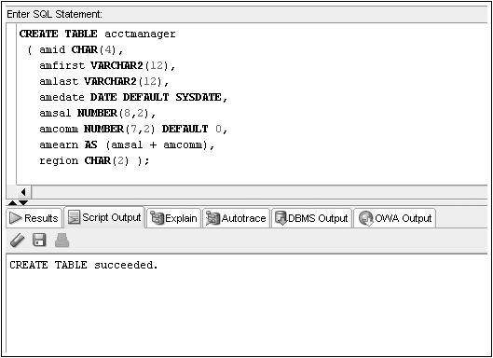
CREATE TABLE Command Example
Virtual Column
7

Slide 8
Meta-data: USER_TABLES
A data dictionary is a typical component of a DBMS that maintains information about database objects
You can query the data dictionary to verify all the tables that exist in your schema
The USER_TABLES data dictionary object maintains information regarding all your tables
8

Slide 9
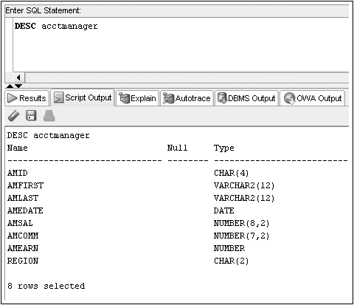
Viewing Table Structures:
DESCRIBE displays the structure of a table
9

Slide 10
Table Creation through Subqueries
You can use subqueries to retrieve data from an existing table
Requires use of AS keyword
New column names can be assigned
10

Slide 11
CREATE TABLE…AS
11

Slide 12
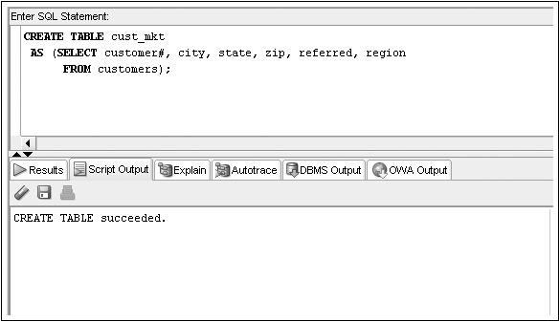
CREATE TABLE…AS Example

Slide 13
Modifying Existing Tables
Accomplished through the ALTER TABLE command
Use an ADD clause to add a column
Use a MODIFY clause to change a column type
Use a RENAME clause to change a column name
Use a DROP COLUMN to drop a column
13

Slide 14
ALTER TABLE Command Syntax
*** There is also a RENAME COLUMN option not specified in this syntax diagram
14

Slide 15
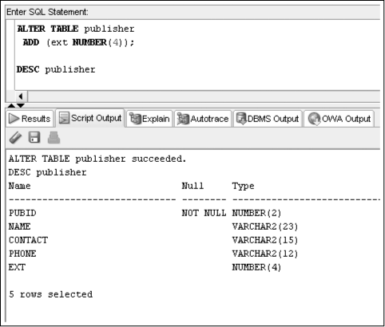
ALTER TABLE…ADD Column
15

Slide 16
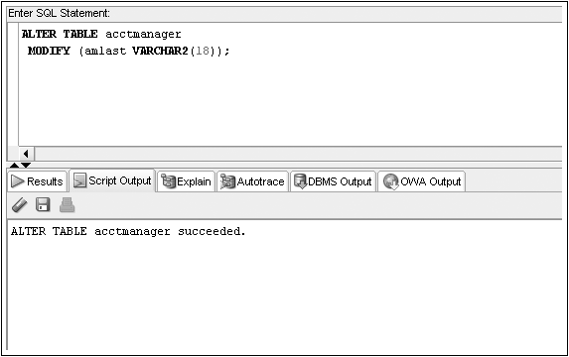
ALTER TABLE…MODIFY Column
16

Slide 17
Modification Guidelines
Column must be as wide as the data it already contains
If a NUMBER column already contains data, size cannot be decreased
Adding or changing default data does not affect existing data
17

Slide 18
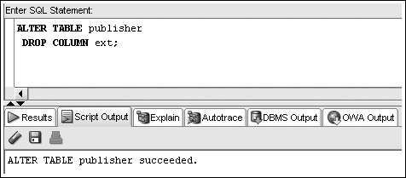
ALTER TABLE…DROP COLUMN
Can only reference one column per execution
Deletion is permanent
Cannot delete last remaining column in a table
18

Slide 19
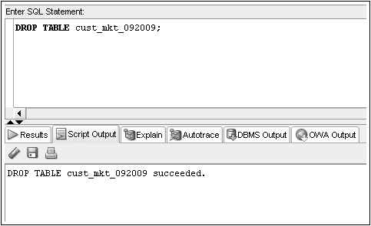
Deleting a Table
DROP TABLE to delete table & contents
19

Slide 20

Loading the JustLee Database
Copy / Paste the contents of JLDB_Build.sql to the SQLDeveloper IDE and build the JustLee database.
CREATE TABLE Customers
(Customer# NUMBER(4),
LastName VARCHAR2(10) NOT NULL,
FirstName VARCHAR2(10) NOT NULL,
Address VARCHAR2(20),
City VARCHAR2(12),
State VARCHAR2(2),
Zip VARCHAR2(5),
Referred NUMBER(4),
Region CHAR(2),
CONSTRAINT customers_customer#_pk PRIMARY KEY(customer#),
CONSTRAINT customers_region_ck
CHECK (region IN ('N', 'NW', 'NE', 'S', 'SE', 'SW', 'W', 'E')));

Slide 21
Oracle 12c: SQL
END OF Chapter 3
Table Creation and Management

